Slide 1

Web scraping to gain company insights
By: Gautam Pande
29/05/24

Slide 2
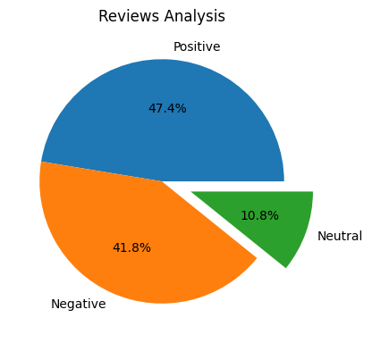
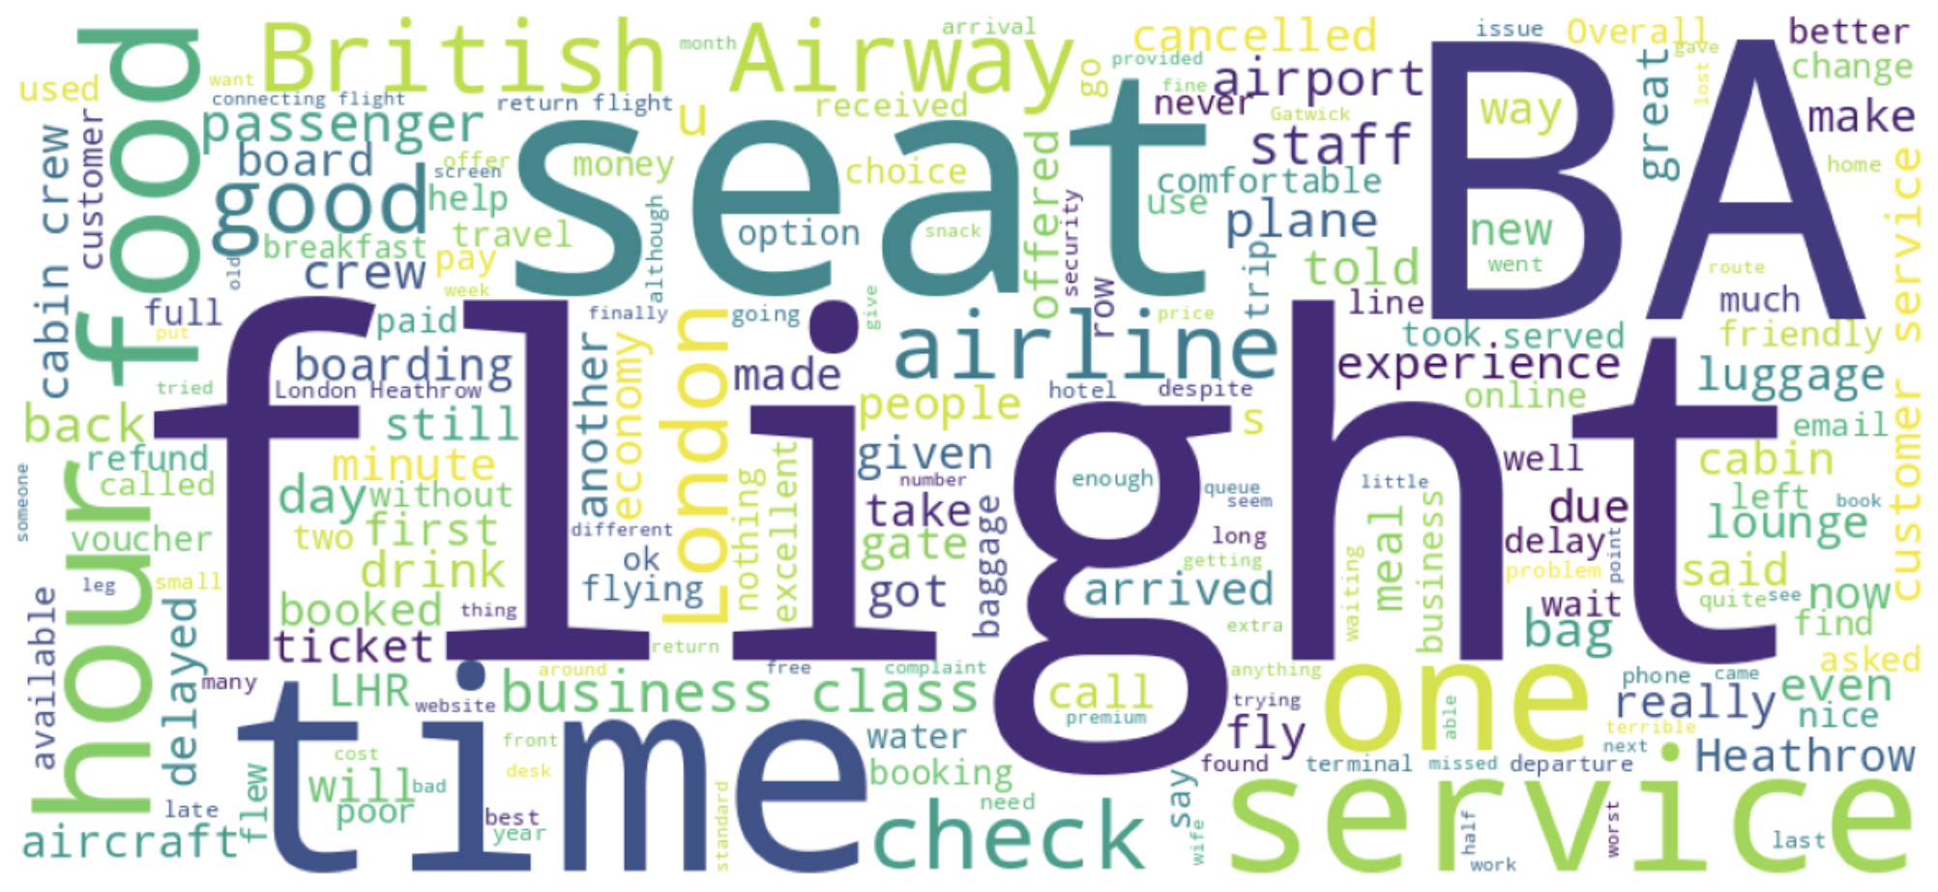
INSIGHTS FROM CUSTOMER REVIEWS
From cleaning 1000 reviews given by the customers, we obtained
Positive reviews : 474
Negative reviews : 418
Neutral reviews : 108
Word cloud of keywords used in reviews

